Slide 1
บทที่ 02 : Modeling

Slide 2
Previous Topic
Boolean Model
Vector Model

Slide 3
Probabilistic Model
Objective: to capture the IR problem using a probabilistic framework
Given a user query, there is an ideal answer set
Querying as specification of the properties of this ideal answer set (clustering)
But, what are these properties?
Guess at the beginning what they could be (i.e., guess initial description of ideal answer set)
Improve by iteration

Slide 4
Probabilistic Ranking Principle
Given a user query q and a document dj, the probabilistic model tries to estimate the probability that the user will find the document dj interesting (i.e., relevant). The model assumes that this probability of relevance depends on the query and the document representations only. Ideal answer set is referred to as R and should maximize the probability of relevance. Documents in the set R are predicted to be relevant.
But,
  how to compute probabilities?
  what is the sample space?

Slide 5
The Ranking
Probabilistic ranking computed as:
  sim(q,dj) = P(dj relevant-to q) / P(dj non-relevant-to q)
  This is the odds of the document dj being relevant
  Taking the odds minimize the probability of an erroneous judgement
Definition:
  wij ∈ {0,1}
  P(R | vec(dj)) : probability that given doc is relevant
  P(¬R | vec(dj)) : probability doc is not relevant

Slide 6
Where do the probabilities fit?
Utility
Human Judgment
Information Need
Document
Query Formulation
Query Processing
Query
Document Processing
Representation Function
Representation Function
Query Representation
Document Representation
Comparison Function
sim(d,q)
P(d is Rel | q)
Retrieval Status Value
Notes:
6
Start 1:20

Slide 7
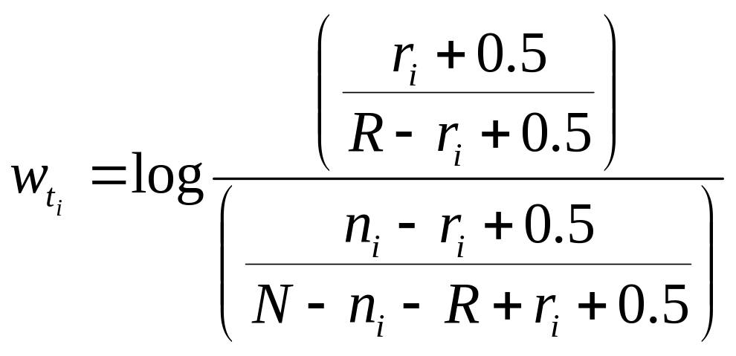
BIR Model
Assume the user provides feedback whether the retrieved docs are relevant or not
  -R = number of docs marked as relevant
  -N = num of docs
  -r = number of relevant docs containing t
  -n = number of docs containing t

Slide 8
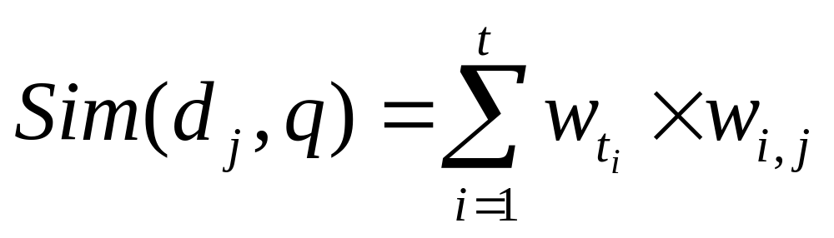
Degree of Similarity

Slide 9
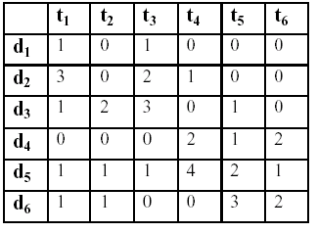
Example
Q1 = (2,0,2,0,0,0)
Assume that D1 , D2 are relevant to Q1

Slide 10
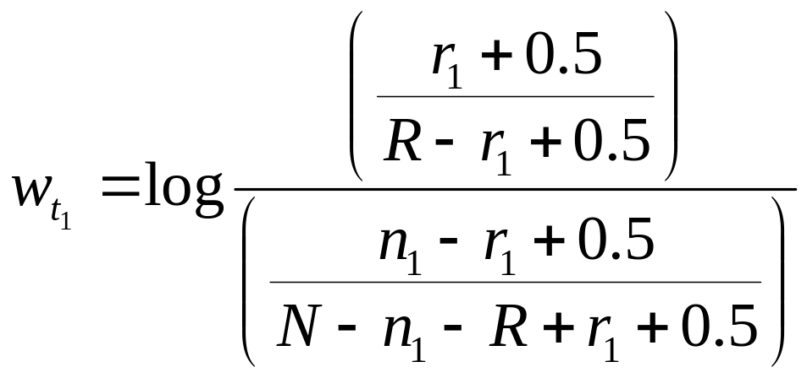
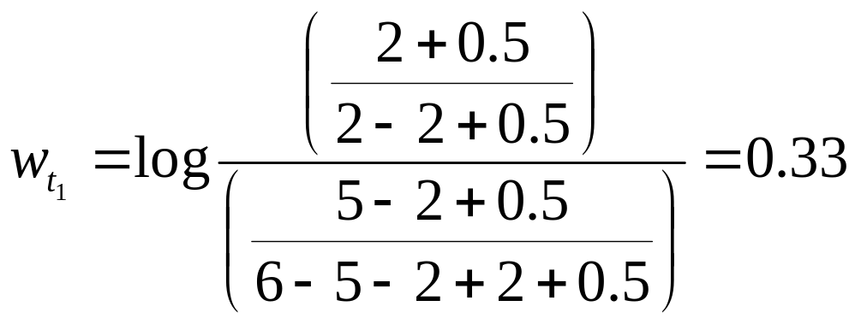
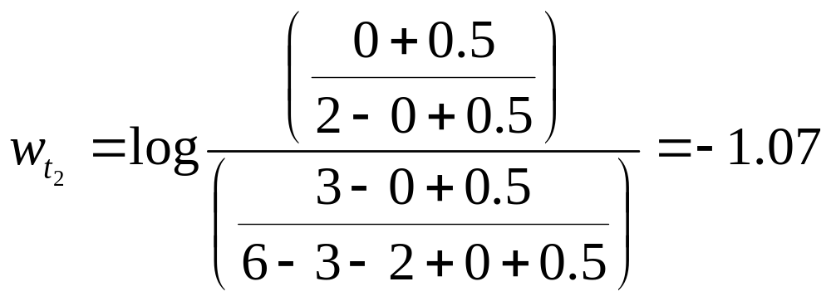
Wt₃ = 0.70
Wt₄ = 0
Wt₅ = -1.65
Wt₆ = -0.17

Slide 11
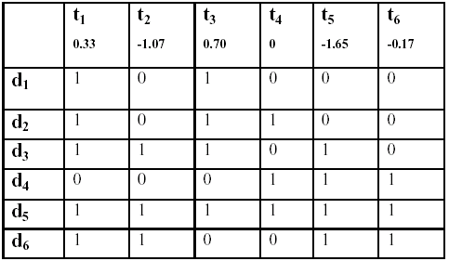
Ranking for Q1
D1
D2
D3
D4
D5
D6
Sim(q1, d1) = 0.33+0.70 = 1.03;
Sim(q1, d2) = 0.33+0.70+0= 1.03;
Sim(q1, d3) = 0.33-1.07+0.70-1.65= -1.69;
Sim(q1, d4) = 0 –1.65-0.17= -1.82;
Sim(q1, d5) = 0.33-1.07+0.70+0-1.65-0.17 = -1.86;
Sim(q1, d6) = 0.33-1.07-1.65-0.17 = -2.56;

Slide 12
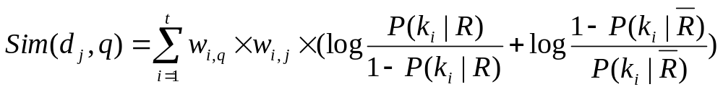
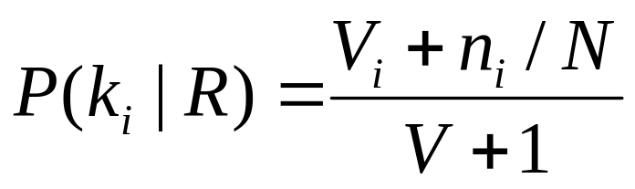
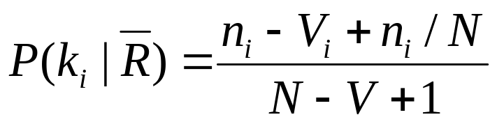
Fuhr model
Assume the user provides feedback whether the retrieved docs are relevant or not
  -V = number of docs marked as relevant
  -N = num of docs
  -V_{i} = number of relevant docs containing t
  -n = number of docs containing t

Slide 13
Example
D1 : “Probabilistic is classic information retrieval model.” (R)
D2 : ”Probability of information retrieval model.” (NR)
D3 :”Information and data retrieval are difference.” (NR)
D4: ”Evaluation is probabilistic work.” (NR)
Query Term | Relevant | Not Relevant
difference | 0 | 1/3
information | 1 | 2/3
model | 1 | 1/3
probabilistic | 1 | 1/3
retrieval | 1 | 2/3

Slide 14
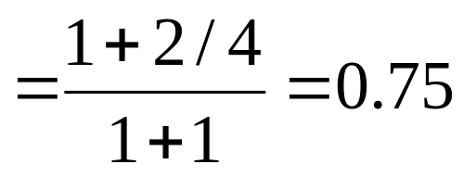
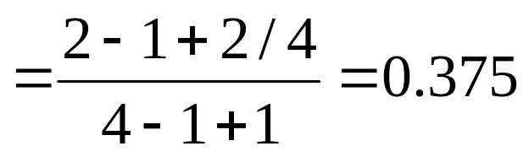
Example
Probabilistic

Slide 15
Example
Query Term | Relevant | Not Relevant
difference | 0.125 | 0.313
information | 0.875 | 0.688
model | 0.75 | 0.375
probabilistic | 0.75 | 0.375
retrieval | 0.875 | 0.688

Slide 16
Example

Slide 17

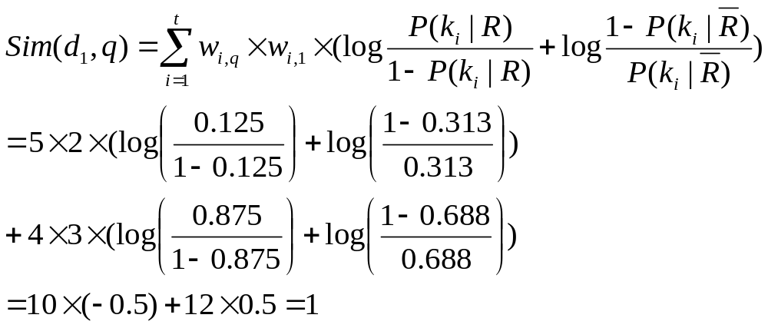
 | Difference | Information | Model | Probabilistic | Retrieval
D1 | 2 | 3 | 5 | 0 | 2
D2 | 0 | 2 | 4 | 0 | 1
D3 | 0 | 0 | 2 | 2 | 2
D4 | 3 | 0 | 0 | 0 | 0
q | 5 | 4 | 0 | 0 | 0

Slide 18
Example
Doc | Sim
D1 | 1
D2 | 4
D3 | 0
D4 | -15
Ranking for Q1
D2
D1
D3
D4

Slide 19
Pluses and Minuses
Advantages:
  Docs ranked in decreasing order of probability of relevance
Disadvantages:
  need to guess initial estimates for P(ki | R)
  method does not take into account tf and idf factors

Slide 20
Modeling (Structured Text Models)

Slide 21
Introduction
Keyword-based query answering considers that the documents are flat i.e., a word in the title has the same weight as a word in the body of the document
But, the document structure is one additional piece of information which can be taken advantage of
For instance, words appearing in the title or in sub-titles within the document could receive higher

Slide 22
Basic Definitions
Match point: the position in the text of a sequence of words that match the query
  Query: “atomic holocaust in Hiroshima”
  Doc dj: contains 3 lines with this string
  Then, doc dj contains 3 match points
Region: a contiguous portion of the text
Node: a structural component of the text such as a chapter, a section, etc

Slide 23
Non-Overlapping Lists
Due to Burkowski, 1992.
Idea: divide the text in non-overlapping regions which are collected in a list
Multiple ways to divide the text in non-overlapping parts yield multiple lists:
  a list for chapters
  a list for sections
  a list for subsections
Text regions from distinct lists might overlap

Slide 24
Non-Overlapping Lists
L₀
Chapter
L₁
Sections
L₂
SubSections
L₃
SubSubSections

Slide 25
Conclusions
The non-overlapping lists model is simple and allows efficient implementation
But, types of queries that can be asked are limited
Also, model does not include any provision for ranking the documents by degree of similarity to the query
What does structural similarity mean?

Slide 26
Proximal Nodes
Due to Navarro and Baeza-Yates, 1997
Idea: define a strict hierarchical index over the text. This enrichs the previous model that used flat lists.
Multiple index hierarchies might be defined
Two distinct index hierarchies might refer to text regions that overlap

Slide 27
Definitions
Each indexing structure is a strict hierarchy composed of
  chapters
  sections
  subsections
  paragraphs
  lines
Each of these components is called a node
To each node is associated a text region

Slide 28
Proximal Nodes
Chapter
Sections
SubSections
SubSubSections
holocaust
10
256
48,324

Slide 29
Proximal Nodes
Key points:
  In the hierarchical index, one node might be contained within another node
  But, two nodes of a same hierarchy cannot overlap
  The inverted list for keywords complements the hierarchical index
  The implementation here is more complex than that for non-overlapping lists

Slide 30
Proximal Nodes
Query: find the sections, the subsections, and the subsubsections that contain the word “holocaust”
  [(*section) with (“holocaust”)]
Simple query processing:
  traverse the inverted list for “holocaust” and determine all match points
  use the match points to search in the hierarchical index for the structural components

Slide 31
Conclusions
Model allows formulating queries that are more sophisticated than those allowed by non-overlapping lists
To speed up query processing, nearby nodes are inspected
Types of queries that can be asked are somewhat limited (all nodes in the answer must come from a same index hierarchy!)
Model is a compromise between efficiency and expressiveness

